Slide 1
Think Locally, Act Globally: Federated Learning with Local and Global Representations

Slide 2
Problems
Communication Cost
Heterogeneous Data
Fair Representation

Slide 3
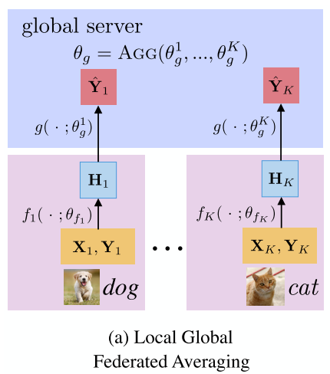
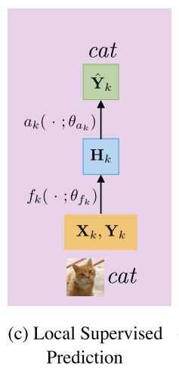
LG-Federated Averaging

Slide 4
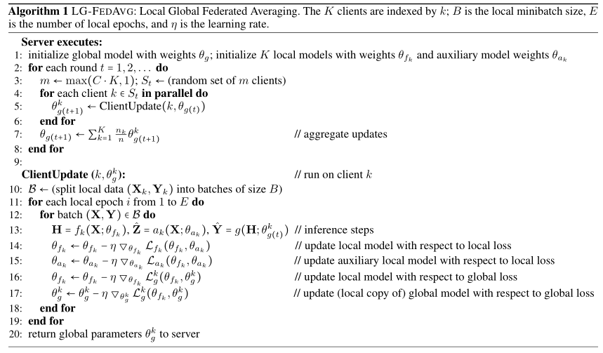
Algorithm

Slide 5
Fair Representation Learning
adversarial model：
If varies with p, then the corresponding correlation can be captured by adversary . On the other hand, if is indeed invariant with repect to p, then adversary should perform as poorly as random choice.

Slide 6
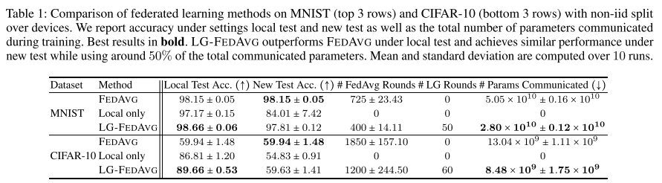
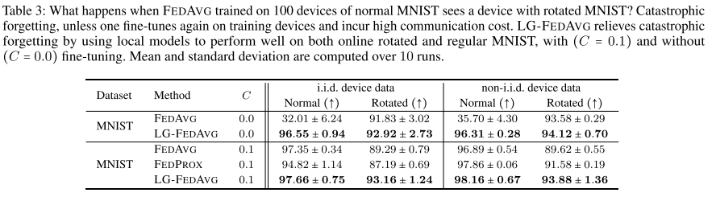
Experiments

Slide 7
Asynchronous Federated Optimization

Slide 8
Problems
Synchronous flavor of federated optimization is potentially unscalable, inefficient, and inflexible. since the task scheduling varies from device to device due to limited computational capacity and battery time, it is difficult to synchronize the selected devices at the end of each epoch.

Slide 9
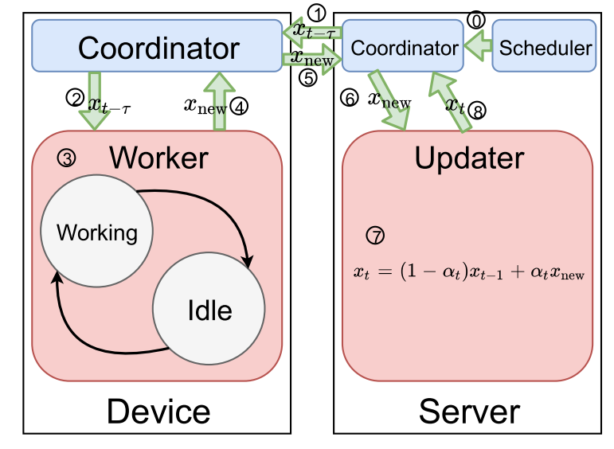
Asy Federated Optimization

Slide 10
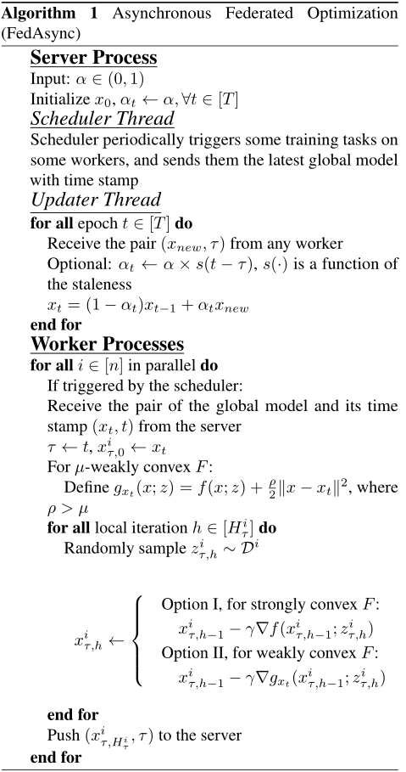
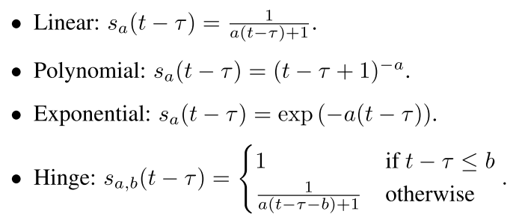
Algorithm
As shown in Algorithm 1, optionally, we use a function s(t − τ) to decide the value of α. We list some choices for s(t − τ), parameterized by a > 0, b ≥ 0:

Slide 11
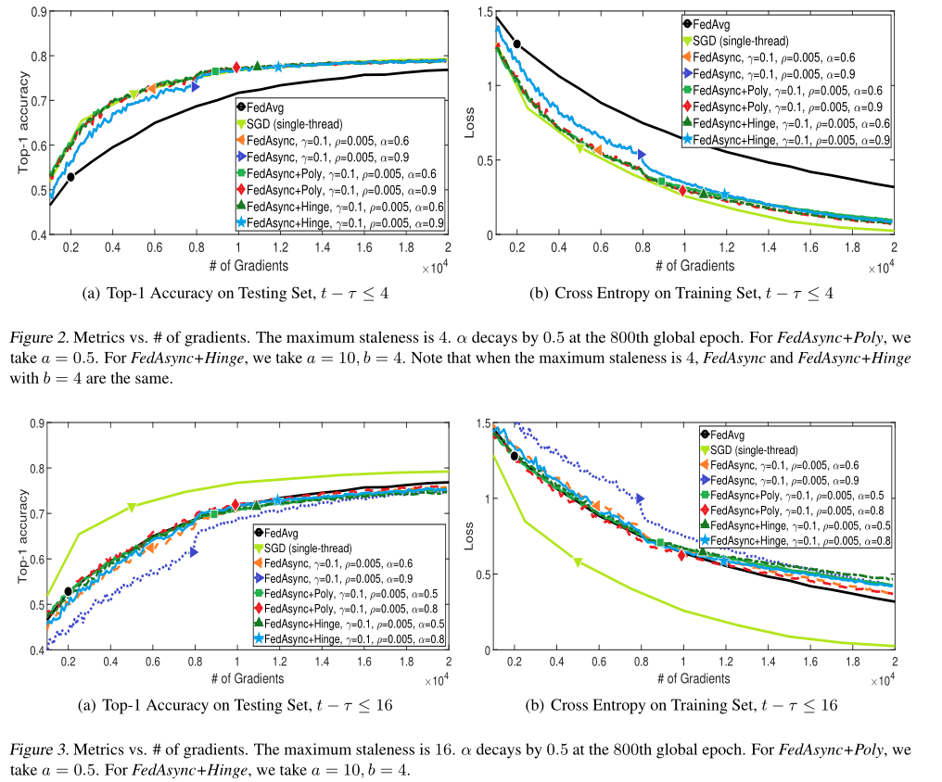
Experiments

